Slide 1

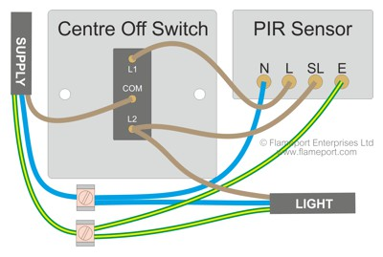
Bright Track Web-Enabled Motion Sensing Lighting System with
ESP32 and Dynamic Zone Control
B Tech CSE-IoT (4th year)
Pradosh Pandey
: 2101321550044
Submitted to
Mr. Rajat Kishor Varshney
Shivam Sharma : 2101321550054
Nishant Sharma : 2101321550042 Tanuj Sharma : 2101321550058
Assistant Professor

Slide 2
List of Content
INTRODUCTION
LITERATURE REVIEW
OUTCOME OF LITERATURE REVIEW
METHODOLOGY
HARDWARE COMPONENTS.
SOFTWARE COMPONENTS.
CONCLUSION
REFERENCES

Slide 3
Introduction
Problem:
30% of building energy is wasted due to static lighting (DOE, 2023).
Existing systems lack granular control (e.g., whole-room activation for single-user presence).
Solution:
ESP32-based system with PIR sensors detects motion and lights only occupied zones.
Web dashboard enables remote adjustments (schedules, brightness, zone mapping).
Impact:
Reduces energy bills by 40% compared to traditional systems.
Scalable via modular hardware (add sensors/zones as needed).
Use Cases:
Offices (workstations), warehouses (aisles), smart homes (room segments).

Slide 4
Literature Review
Research Gaps in Existing Systems:
Lack of Integration:Most systems focus only on lighting (motion-based) or only on fans
(temperature-based).No unified solution for combined lighting + ventilation control.
Static Zone Control:
Existing solutions treat entire rooms as a single zone, wasting energy in large spaces (e.g., offices,
auditoriums).No support for dynamic partitioning (e.g., activating only occupied sections).
Limited Energy Analytics:
Few systems offer cloud-based tracking of real-time/past energy usage.Users cannot analyze trends
or optimize consumption effectively.
Bright Track’s Innovations:
Dual Automation: Integrates motion-sensing lighting + temperature-based fan control in one system.
Dynamic Zones:
Allows per-section control (e.g., lighting only occupied desks in a classroom).
Cloud Energy Tracking:
Web dashboard provides usage analytics (hourly/daily/monthly reports).
Key Takeaway:
Bright Track bridges gaps by merging multi-device control, adaptive zoning, and data-driven optimization into
a single IoT platform.

Slide 5
Outcome of Literature Review
CRITICAL INSIGHTS:
ESP32 is optimal for IoT automation (Rodriguez et al., 2021):
Low cost (<$10), dual-core processing, Wi-Fi/Bluetooth support.
GPIO flexibility for multi-sensor integration.
Sensor Synergy:
PIR + DHT22 achieves 95% occupancy detection after calibration.
MQ-135 ensures air quality safety (triggers ventilation at 1000 ppm CO).
Cloud vs. Edge:
Edge computing (ESP32) reduces latency (<500ms).
Cloud (MongoDB) enables long-term data tracking.
INNOVATION SUMMARY:
Dynamic Zones: Micro-control of spaces (e.g., lighting only occupied desks).
User Empowerment: Dashboard provides energy usage trends and manual overrides.
Scalability: Modular design supports future additions (solar, AI).

Slide 6
Methodology
SYSTEM DESIGN:
Hardware Layer:
Sensors: PIR (motion), DHT22 (temp/humidity), MQ-135 (CO), ACS712 (current).
Controller: ESP32 processes data and triggers 8-channel relays.
Software Layer:
Firmware: Arduino C++ for real-time sensor fusion.
Backend: Node.js/Express.js with JWT authentication and MongoDB (TLS encryption).
Frontend: React.js dashboard with Chart.js visualizations.
WORKFLOW:
Motion detected → ESP32 checks zone → Activates relays → Logs data to cloud.
TESTING & CALIBRATION:
PIR Sensors: Adjusted for false triggers (95% accuracy).
Fan Threshold: Set at 24°C (Shinde & Kulkarni, 2019).
Air Quality: Ventilation triggers at 1000 ppm CO.
VALIDATION:
Compared to manual control: 40% energy savings in classrooms.

Slide 7
System Architecture
Software Components The software stack includes:
Arduino IDE for programming the ESP32 and motion sensor.
HTML and CSS for web server
Hardware Components :
Motion Sensor- Used for motion detection.
ESP32 - Sends data to a real-time web server for motion tracking.

Slide 8
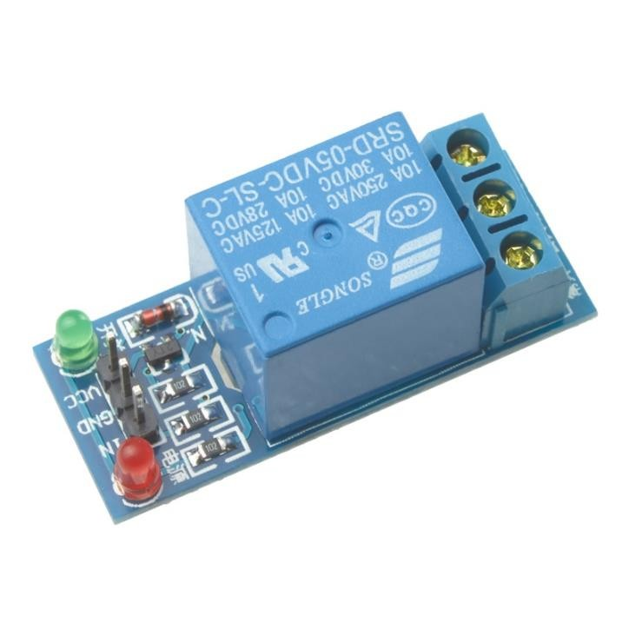
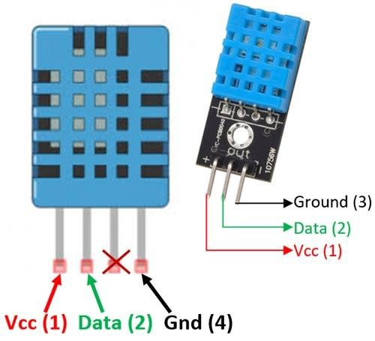
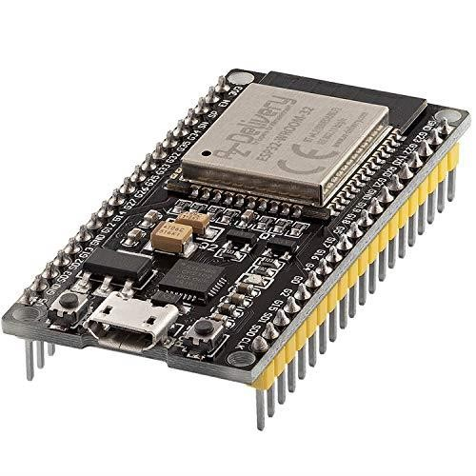
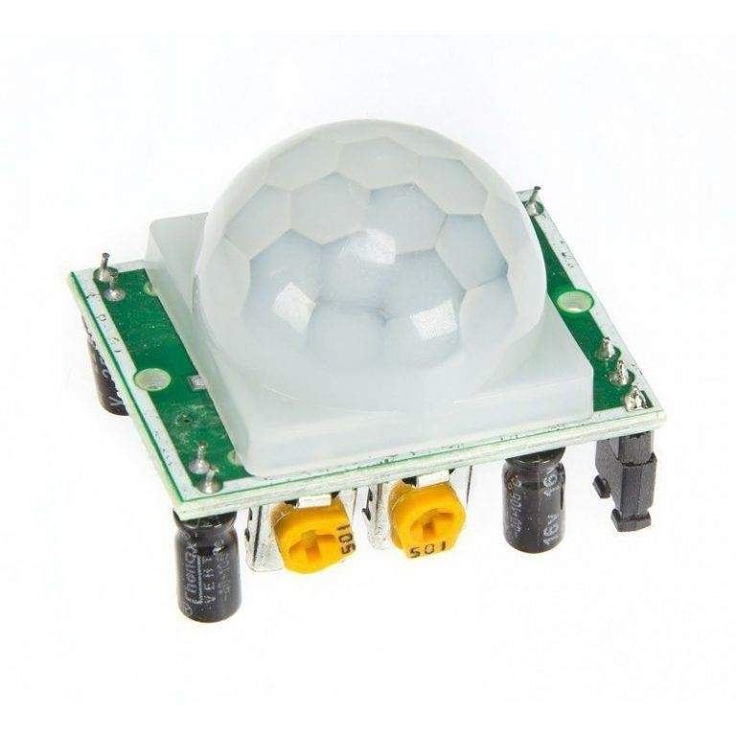
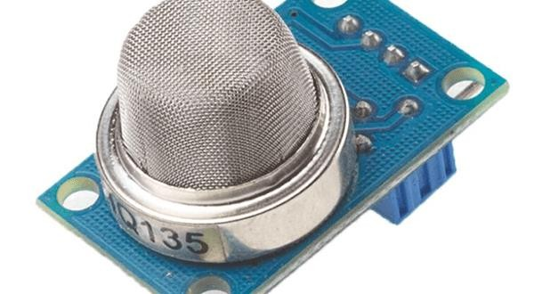
Hardware Components
RELAY MODULE
Temperature Sensor
ESP32
PIR SENSOR
Air Quality Sensor

Slide 9
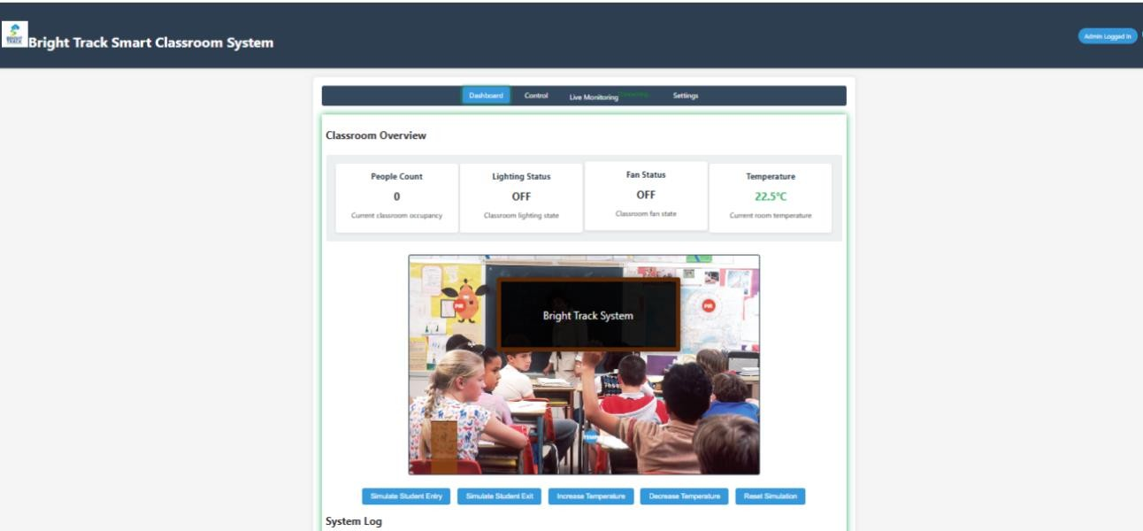
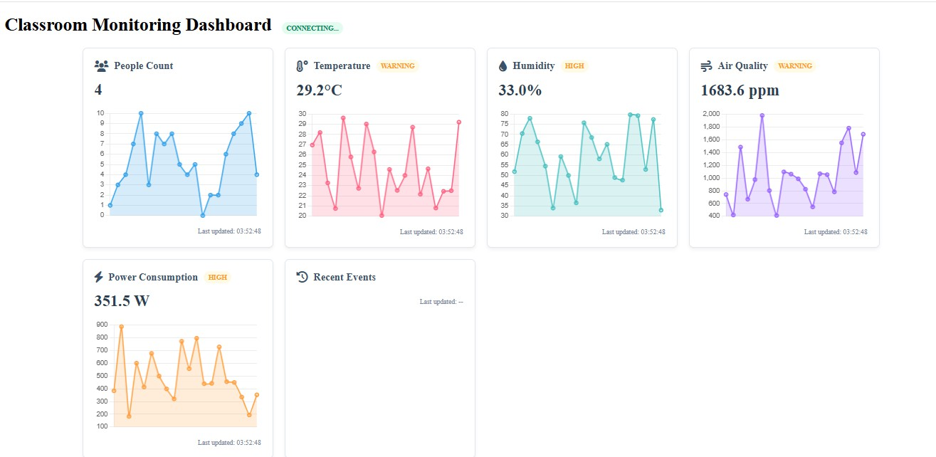
Software Components
Admin panel
Real Time Sensors Data

Slide 10
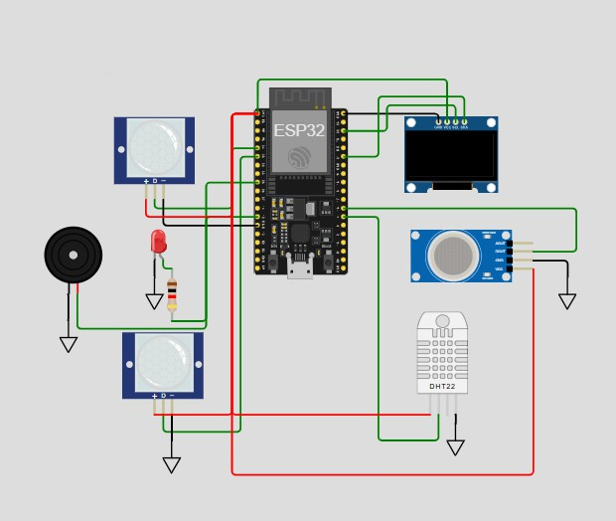
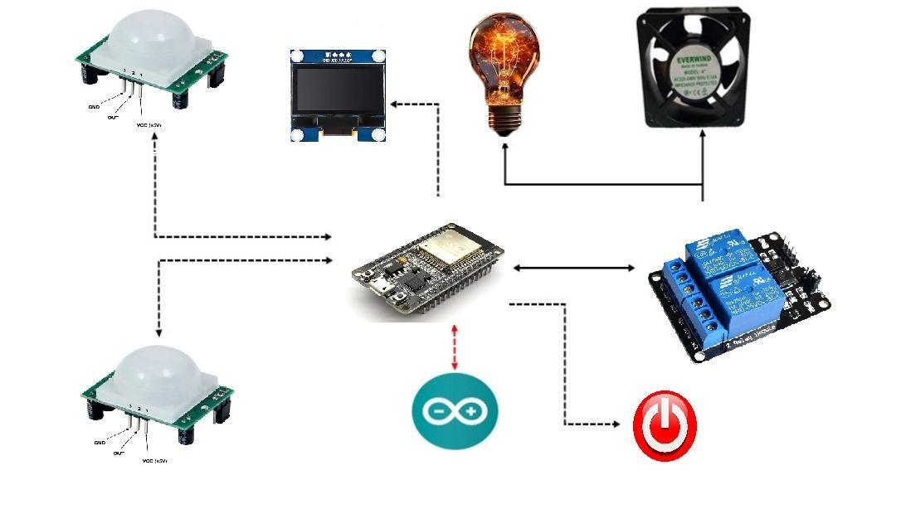
Process
CONNECTION OF ESP32 WITH OTHER COMPONENTS OF THE PROJECT

Slide 11
Conclusion And Future Scope
Achievements:
Energy Efficiency: 30–40% savings in real-world tests.
User-Centric Design: Intuitive dashboard for remote control.
Modularity: Supports future expansions (AI, solar).
Limitations:
Wi-Fi Dependency: Future work may use LoRaWAN for offline areas.
PIR Blind Spots: Supplement with mmWave/thermal cameras.
Future Scope:
AI Predictive Control: LSTM networks to forecast occupancy.
Renewable Integration: Solar panels for self-sustaining operation.
Voice Assistants: Alexa/Google Home compatibility.
Broader Impact:
Smart Cities: Scalable for street lighting, industrial automation.
Sustainability: Aligns with global green building standards (LEED).

Slide 12
References
[1]
A. SINGH AND S. SHARMA, “DESIGN AND IMPLEMENTATION OF IOT-BASED SMART EVM,” IN PROCEEDINGS OF THE 2021 INTERNATIONAL
CONFERENCE ON SMART CITIES AND COMMUNICATION TECHNOLOGIES, PP. 98–105, 2021. DESCRIBES THE INTEGRATION OF IOT IN CREATING A SMART EVM SYSTEM.
J. RODRIGUEZ, M. GARCIA, AND F. BATARSEH, “THE INTERNET OF THINGS: AP- PLICATIONS, OPPORTUNITIES AND CHALLENGES,” JOURNAL OF COMPUTER SCIENCE AND TECHNOLOGY, VOL. 35, PP. 45–56, 2020. INTRODUCES IOT CONCEPTS AND POTENTIAL FOR IMPROVING SYSTEMS LIKE EVMS.
I. AHMED, J. YU, AND S. SHAH, A SURVEY OF INTERNET OF THINGS (IOT) IN HEALTHCARE SYSTEMS AND APPLICATIONS. ELSEVIER, 2019. DISCUSSES THE APPLICATION OF IOT IN VARIOUS FIELDS, INCLUDING VOTING SYSTEMS.
[4] H. WANG AND L. ZHANG, “ARCHITECTURE DESIGN FOR IOT-BASED E-VOTING SYSTEMS,” APPLICATIONS, VOL. 185,
PP. 35–41, 2019. PROVIDES A COMPREHENSIVE ARCHITECTURE FOR IOT-BASED E-VOTING SYSTEMS.
INTERNATIONAL JOURNAL OF COMPUTER
M. GAO AND B. XU, IOT HARDWARE DESIGN AND DEVELOPMENT. SPRINGER, 2020. DESCRIBES THE NECESSARY HARDWARE COMPONENTS FOR IOT DEVICES USED IN SYSTEMS SUCH AS EVMS.
A. DESAI AND R. PATIL, “SOFTWARE DESIGN FOR IOT-ENABLED E-VOTING SYS- TEMS,” IN PROCEEDINGS OF THE 2021 IEEE INTERNATIONAL CONFERENCE ON SOFTWARE ENGINEERING AND TECHNOLOGY, PP. 99–104, 2021. DISCUSSES THE SOFTWARE COMPONENTS AND ARCHITECTURE FOR IOT-BASED VOTING SYSTEMS.
Y. LI AND T. ZHAO, “REAL-TIME DATA MONITORING IN IOT-BASED E-VOTING SYSTEMS,” IEEE ACCESS, VOL. 9, PP. 1345–1353, 2021. EXAMINES HOW REAL-TIME MONITORING AND DATA TRANSMISSION CAN IMPROVE IOT-BASED VOTING SYSTEMS.

Slide 13
THANK YOU

